Slide 1
The Apparel Question
Presented by: JHT

Slide 2
ASPECTS OF SALVATION
PAST | PRESENT | FUTURE
WE WERE SAVED | WE ARE BEING SAVED | WE WILL BE SAVED
JUSTIFIED | SANCTIFIED | GLORIFIED
POSITIONAL | EXPERIENTIAL | ETERNAL
RIGHTEOUSNESS IMPUTED | RIGHTEOUSNESS IMPARTED | RIGHTEOUSNESS IMPLANTED
SAVED FROM PENALTY OF SIN | BEING SAVED FROM POWER OF SIN | WE WILL BE SAVED FROM THE PRESENCE OF SIN

Slide 3
Deuteronomy 22:5 King James Version (KJV) The woman shall not wear that which pertaineth unto a man, neither shall a man put on a woman's garment: for all that do so are abomination unto the LORD thy God.
WHY DOES THE BIBLE HAVE MORE “EXTERNAL STANDARDS” FOR WOMEN THAN FOR MEN?

Slide 4
MEN ARE STIMULATED BY SIGHT
Matthew 5:28
King James Version (KJV)
But I say unto you, That whosoever looketh on a woman to lust after her hath committed adultery with her already in his heart.

Slide 5
WOMEN ARE MORE TO ENTICING DRESS
1 Timothy 2:9-10
King James Version (KJV)
9In like manner also, that women adorn themselves in modest apparel, with shamefacedness and sobriety; not with broided hair, or gold, or pearls, or costly array;
10But (which becometh women professing godliness) with good works.
3Whose adorning let it not be that outward adorning of plaiting the hair, and of wearing of gold, or of putting on of apparel;
4But let it be the hidden man of the heart, in that which is not corruptible, even the ornament of a meek and quiet spirit, which is in the sight of God of great price.
1 Peter 3:3-4

Slide 6
WOMEN ARE STIMULATED BY TOUCH
1 Corinthians 7:1
King James Version (KJV)
1Now concerning the things whereof ye wrote unto me: It is good for a man not to touch a woman.

Slide 7
WOMAN - APPEAR MAN - ACT

Slide 8
DRESS MATTERS!
1 Samuel 16:7
King James Version (KJV)
7But the LORD said unto Samuel, Look not on his countenance, or on the height of his stature; because I have refused him: for the LORD seeth not as man seeth; for man looketh on the outward appearance, but the LORD looketh on the heart.

Slide 9
IMMATURITY

Slide 10
WORLDLY SPIRIT

Slide 11
INCORRECT TEACHING

Slide 12
CLOTHING IS VERY SIGNIFICANT IN SCRIPTURE!
- Clothing for modesty’s sake was instituted by God.
Genesis 3:21
- Nakedness is a mark of shame.
Ezekiel 16:39, Luke 8:27
- Jesus was concerned about external covering as well
as internal deliverance.
Mark 5:15
- Clothing is used to indicative a negative spiritual state.
2 Sam. 14:2, Psalms 35:13, Psalms 109:18, Psalms 109:29 Eze 7:27
- The wearing of proper clothing is commanded by God.
1Tim 2:9, 1Pet 3:3

Slide 13
CLOTHING IS VERY SIGNIFICANT IN SCRIPTURE!
- Improper clothing displeases the Lord greatly.
Zephaniah 1:8, Deutoronomy 22:5
- Those improperly dressed were prohibited from
the king’s presence
Esther 4:2
- A change of clothing was required to be in royal
presence or in God’s presence
Esther 5:1, 2Samuel 12:20
- Clothing is used to indicative the blessings of a king.
Esther 6:9, Esther 8:15
- A king’s glory was evidenced by the clothing of His
servants.
1Tim 2:9, 1Pet 3:3

Slide 14
CLOTHING IS VERY SIGNIFICANT IN SCRIPTURE!
- Clothing is indicative of personal purity.
2Samuel 13:18
- Clothing is indicative of a repentant atitude.
Joshua 7:6, 2Chronicles 34:19, 2Chronicles 34:27
- Clothing is used as a type of spirituality.
Ps.132:16, Ps.132:18,Zech.3:4, Prov.31:25, Isa.59:17, Job 29:14,
Ps.132:9, Isa.61:10, 1Pet.5:5
- Clothing is the identifiable mark of the redemed in
eternity.
Rev.4:4, Rev.7:9, Rev.19:14, Rev. 19:8

Slide 15
The Apostate Spirit of the Last Days will Reject Holiness Teaching!
Isaiah 4:1
King James Version (KJV)
And in that day seven women shall take hold of one man, saying, We will eat our own bread, and wear our own apparel: only let us be called by thy name, to take away our reproach.

Slide 16
They want to be bride of Christ BUT IN THEIR OWN TERMS!
Isaiah 4:1 “And in that day seven women shall take hold of one man, saying, We will eat our own bread, and wear our own apparel: only let us be called by thy name, to take away our reproach.” | Revelation 2:1 “ Unto the angel of the church of Ephesus write; These things saith he that holdeth the seven stars in his right hand, who walketh in the midst of the seven golden candlesticks;”
7 would-wanna-be bride of Isaiah 4:1 are prophetic picture of the church in the last days. | Last Days’ Church is represented by seven candlesticks in Revelation Chapters 1-3
All seven women like to take hold of one man. | 7 Churches want to take hold of one man, Jesus.
They want their own bread. | Churches today wants only to eat of their own bread, their own interpretation of God’s word.
They want to wear their own apparel. | Many churches today want to wear their own apparel, rejecting separation from the world, reproof, holiness preaching, spiritual authority, and anything they think is negative.

Slide 17
5 PRINCIPLES OF CHRISTIAN APPAREL:
DRESS AND APPEARANCE ARE AN IMPORTANT INDICATOR OF CHRISTIAN CHARACTER.
SCRIPTURE IS CONSISTENT IN ITS CONDEMNATION OF IMPROPER APPAREL.
CHRISTIANS ARE REQUIRED TO DRESS MODESTLY, SHOWING RESPECT FOR GOD, THEMSELVES, AND OTHERS.
CHRISTIANS MUST RESPECT GENDER DISTINCTIONS IN CLOTHING BY WEARING APPAREL THAT AFFIRMS THEIR MALE OR FEMALE IDENTITIES. LIKE MOST HOLINESS ISSUES, THIS PRINCIPLE GOES BACK TO CREATION!
CLOTHES DO NOT MAKE A CHRISTIAN, BUT REAL CHRISTIANS ALWAYS REVEAL THEIR IDENTITY THROUGH THEIR MODEST CLOTHING AND APPEARANCE!

Slide 18
THIS TRUTH IS TAUGHT IMPLICITLY BY MANY NEGATIVE EXAMPLES IN THE OLD TESTAMENT, AND EXPLICITLY BY THE ADMONITIONS OF PAUL AND PETER.
PORTION OF SCRIPTURE | TYPE OF INSTRUCTION | ACHIEVED BY
OLD TESTAMENT | IMPLICIT TEACHING | NEGATIVE EXAMPLES
NEW TESTAMENT | EXPLICIT TEACHING | POSITIVE ADMONITIONS

Slide 19
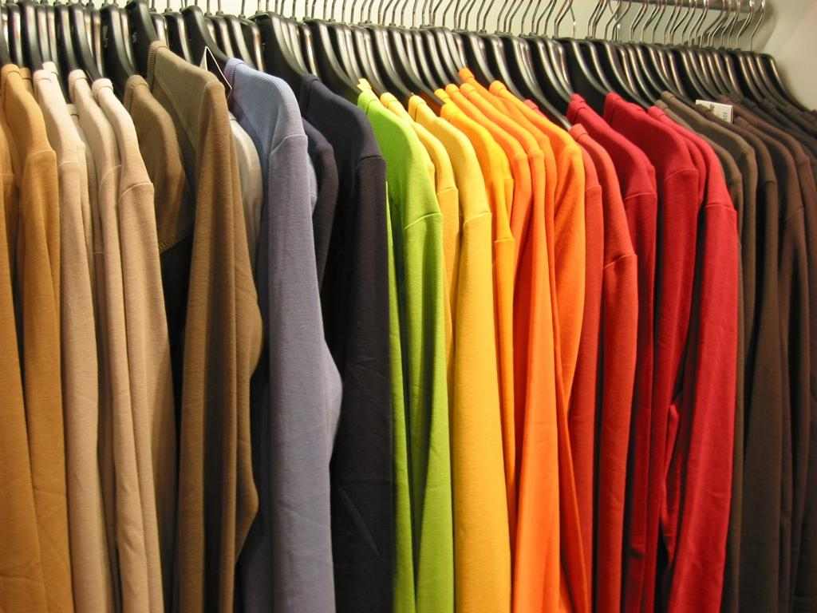
TRACE THE CONCEPT OF APPAREL THROUGH THE SCRIPTURES:

Slide 20
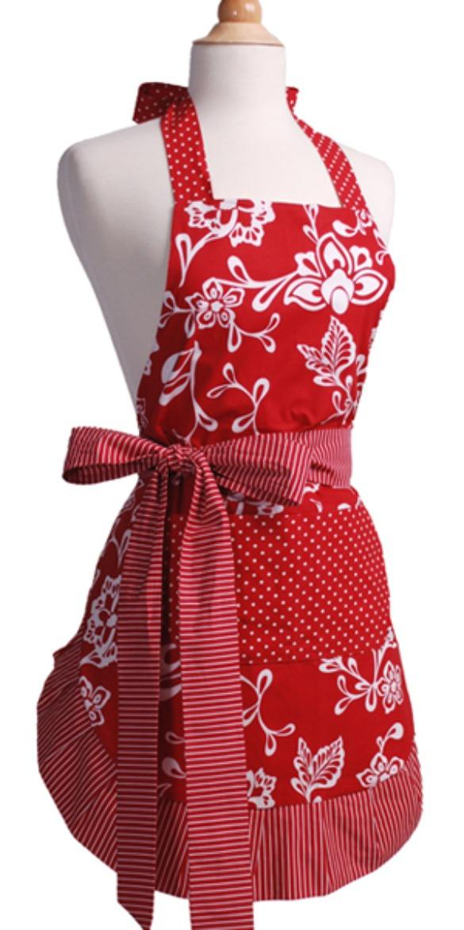
1. Mankind’s First Clothing
Genesis 3:6-10
King James Version (KJV)
6And when the woman saw that the tree was good for food, and that it was pleasant to the eyes, and a tree to be desired to make one wise, she took of the fruit thereof, and did eat, and gave also unto her husband with her; and he did eat.
7And the eyes of them both were opened, and they knew that they were naked; and they sewed fig leaves together, and made themselves APRONS.
8And they heard the voice of the LORD God walking in the garden in the cool of the day: and Adam and his wife hid themselves from the presence of the LORD God amongst the trees of the garden.
9And the LORD God called unto Adam, and said unto him, Where art thou?
10And he said, I heard thy voice in the garden, and I was afraid, because I was naked; and I hid myself.
BEFORE SIN!
Genesis 2:25
King James Version (KJV)
And they were both naked, the man and his wife, and were not ashamed.

Slide 21
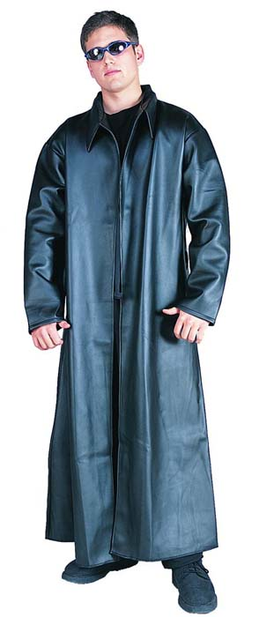
So God made them COATS!
Genesis 3:21
King James Version (KJV)
Unto Adam also and to his wife did the LORD God make COATS
of skins, and clothed them.

Slide 22
LET US ABIDE IN GOD’S STANDARD!
APRON | COAT
FROM HEBREW WORD “HAGORA” MEANS GIRDLE, BELT, LOINCLOTH, APRON, LOIN-COVERING, COVERING THE PRIVATE REGION AND HIPS ONLY. | FROM HEBREW WORD “KUTTONET” MEANS TUNIC WITH SLEEVES, COMING DOWN TO THE KNEES, SOMETIMES TO THE ANKLES. GARMENT WITH SLEEVES COVERING FROM SHOULDERS AT LEAST TO THE KNEES.
PARTLY COVERING THE BODY MOST LIKELY JUST THE PRIVATE PARTS | LOOSE FITTING AND PROPERLY COVERING THE WHOLE BODY
MAN’S IDEA OF MODEST APPAREL | GOD’S IDEA OF MODEST APPAREL.
MAN’S STANDARD | GOD’S STANDARD

Slide 23
THE MORAL SHAME OF NAKEDNESS
MAN’S IDEA OF NAKEDNESS IS NUDITY
GOD’S IDEA OF NAKEDNESS IS WHEN UPPER LEG AND TORSO ARE UNCOVERED
Genesis 3:10 - 10And he said, I heard thy voice in the garden, and I was afraid, because I was naked(covered only with an apron); and I hid myself.
Exodus 20:26 - 26Neither shalt thou go up by steps unto mine altar, that thy nakedness be not discovered thereon.
Exodus 28:42 - 42And thou shalt make them linen breeches to cover their nakedness; from the loins even unto the thighs they shall reach:
Isaiah 47:2-3 - 2Take the millstones, and grind meal: uncover thy locks, make bare the leg, uncover the thigh(upper leg), pass over the rivers. 3Thy nakedness shall be uncovered, yea, thy shame shall be seen(GOD CONSIDERS THIS TO BE NAKEDNESS): I will take vengeance, and I will not meet thee as a man.
John 21:7 - 7Therefore that disciple whom Jesus loved saith unto Peter, It is the Lord. Now when Simon Peter heard that it was the Lord, he girt his fisher's coat unto him, (for he was naked,) and did cast himself into the sea.

Slide 24
IN BIBLE, NAKEDNESS...
Nakedness was covered from the beginning by God to defeat the temptation it created.
Nakedness was associated with sexual impulses and desires, so much so that to “see” or “uncover” nakedness is a biblical euphemism for “sexual intercourse.”
Leviticus 20:17
17And if a man shall take his sister, his father's daughter, or his mother's daughter, and see her nakedness, and she see his nakedness; it is a wicked thing; and they shall be cut off in the sight of their people: he hath uncovered his sister's nakedness; he shall bear his iniquity

Slide 25
IN BIBLE, NAKEDNESS...
Nakedness as a moral shame is found from Genesis 3:7 through Revelation 16:15
Revelation 16:15
15Behold, I come as a thief. Blessed is he that watcheth, and keepeth his garments, lest he walk naked, and they see his SHAME.
Nakedness must be covered! This principle is not cultural, but Biblical.

Slide 26
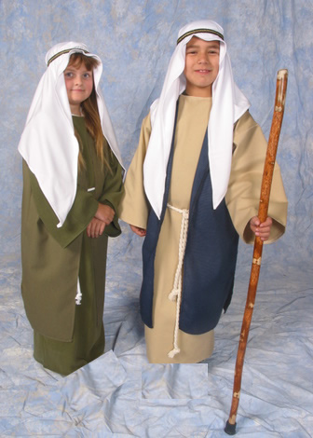
APPAREL IN BIBLE TIMES
Samson’s prize for riddle was 30 sheets and change of garments...Jud.14:12
Achan was tempted by goodly Babylonish garments...Jos.7:21
Gehazi fell along with two changes of garments...2Kin.5:23
Sisera’s mother wished him to return from battle with divers colours of needle work...Jud.5:30

Slide 27
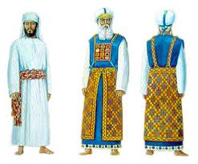
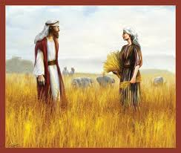
GENDER DISTINCTION IN THE OLD TESTAMENT
If both men and women wore robes; is it possible for gender distinction???
Deuteronomy 22:5
The woman shall not wear that which pertaineth unto a man, neither shall a man put on a woman's garment: for all that do so are abomination unto the LORD thy God.

Slide 28
DISTINCTIVENESS IS BY CONSTRUCTION OF ATTIRE
...that is in their style, color, markings, length, cuts, and trim.
Genesis 24:65
King James Version (KJV)
65For she had said unto the servant, What man is this that walketh in the field to meet us? And the servant had said, It is my master: therefore she took a vail, and covered herself.

Slide 29
WHAT THEY WORE BUT HOW THEY WORE IT
MOST IMPORTANT DISTINCTION

Slide 30
“BREECHES”
Later english word is, “britches”. Synonymous to words; trousers, pants, khaki, denim, jeans, knee pants, slacks

Slide 31
BUT In Every Case it is Man’s Apparel!
Exodus 28:42
King James Version (KJV)
42And thou shalt make them linen breeches to cover their nakedness; from the loins even unto the thighs they shall reach:
Exodus 39:28
King James Version (KJV)
28And a mitre of fine linen, and goodly bonnets of fine linen, and linen breeches of fine twined linen,
Leviticus 6:10
King James Version (KJV)
10And the priest shall put on his linen garment, and his linen breeches shall he put upon his flesh, and take up the ashes which the fire hath consumed with the burnt offering on the altar, and he shall put them beside the altar.
Leviticus 16:4
King James Version (KJV)
4He shall put on the holy linen coat, and he shall have the linen breeches upon his flesh, and shall be girded with a linen girdle, and with the linen mitre shall he be attired: these are holy garments; therefore shall he wash his flesh in water, and so put them on
Ezekiel 44:18
King James Version (KJV)
18They shall have linen bonnets upon their heads, and shall have linen breeches upon their loins; they shall not gird themselves with any thing that causeth sweat.

Slide 32
IMAGINE
For the first 5,900 years pants worn exclusive by men...

Slide 33
But also every time “skirt” is used in the KJV it refers to man; is this a positive case for “cross-dressing” ???
The Hebrew word for skirt however, is “KANAPH”,
which actually means the extreme corner of a garment.

Slide 34
“GIRD UP THY LOINS”
MEN IN BIBLE TIMES WERE PERMITTED TO GIRD UP THEIR LOINS WHILE WOMEN WERE NOT.

Slide 36
II Kings 4:29: Then he said to Gehazi, Gird up thy loins, and take my staff in thine hand, and go thy way: if thou meet any man, salute him not; and if any salute thee, answer him not again: and lay my staff upon the face of the child.
II Kings 9:1: And Elisha the prophet called one of the children of the prophets, and said unto him, Gird up thy loins, and take this box of oil in thine hand, and go to Ramoth–gilead:
Job 38:3: Gird up now thy loins like a man; for I will demand of thee, and answer thou me.
Job 40:7: Gird up thy loins now like a man: I will demand of thee, and declare thou unto me.
Jeremiah 1:17: Thou therefore gird up thy loins, and arise, and speak unto them all that I command thee: be not dismayed at their faces, lest I confound thee before them.
I Peter 1:13: Wherefore gird up the loins of your mind, be sober, and hope to the end for the grace that is to be brought unto you at the revelation of Jesus Christ;

Slide 37
ANY GARMENT THAT SHOWS A SEPARATION OF THE LEGS ABOVE THE KNEE IS IMMODEST APPAREL FOR A GODLY WOMAN. GOD DOES NOT APPROVE OF IT!

Slide 38
Deuteronomy 22:5 King James Version (KJV) The woman shall not wear that which pertaineth unto a man, neither shall a man put on a woman's garment: for all that do so are abomination unto the LORD thy God.
AN ABOMINATION UNTO THE LORD

Slide 41
Deuteronomy 22:5 King James Version (KJV) The woman shall not wear that which pertaineth unto a man(HEB.”GEBER”-SOLDIER or MAN), neither shall a man (HEB.”GEBER”-SOLDIER or MAN) put on a woman's garment: for all that do so are abomination unto the LORD thy God.
NO MAJOR BIBLE TRANSLATION USES THE ENGLISH WORD “SOLDIER” TO TRANSLATE “GEBER” EVEN ONCE.

Slide 42
APOSTOLIC ADMONITIONS IN THE NEW TESTAMENT
1 Timothy 2:8-9
King James Version (KJV)
I will therefore that men pray every where, lifting up holy hands, without wrath and doubting. In like manner also, that women adorn themselves in modest apparel, with shamefacedness and sobriety; not with broided hair, or gold, or pearls, or costly array;

Slide 43
A. MODEST, OR “ORDERLY”
From Greek word “kosmios” which means “well-ordered, becoming, dignified.” Describes self-discipline and attitude reflects outwardly.
What a woman wears affects her conduct and appropriate dress encourages appropriate demeanor.

Slide 44
APPAREL, OR “LONG AND FLOWING”
From the Greek word “katastole” which means “a long flowing garment.” Greek “katastola” which was loose-fitting (flowing) and covered from the neck to the kness (“long”).
Notice Paul requires the same type of garment God required in Genesis 3!

Slide 45
DECENT, OR “WITH SHAMEFACEDNESS”
Shamefacedness comes from Greek word “aidos” which means “a sense of shame, bashfulness, reverence, regard for others.” From root word “eido” which has the significance of “turning the eyes, the mind, the ATTENTION to anything.”
This word has a DEEPER significance in regard to “ADORNMENT” than to “apparel.”

Slide 46
RESTRAINED, OR “WITH SOBRIETY”
Sobriety comes from the greek word “sophrosune” which means “soundness of mind, sound judgement, curbing one’s impulses, self-controlled, temperate.” Signifies inner self-government with constant rein on all passions and desires.
This word also has a deeper significance to “adornment” than to “apparel.”

Slide 47
A WORD TO CHRISTIAN MEN
THERE ARE MORE “EXTERNAL STANDARDS” IN GOD’S WORD FOR WOMEN THAN FOR MEN. HOWEVER, THE PRINCIPLES OF MODESTY, DECENCY AND RESTRAINT CERTAINLY APPLY TO YOUR CLOTHING AS WELL
REMEMBER ADAM’S IDEA OF PROPER COVERING WAS NOT GOD’S IDEA OF PROPER COVERING!

Slide 48
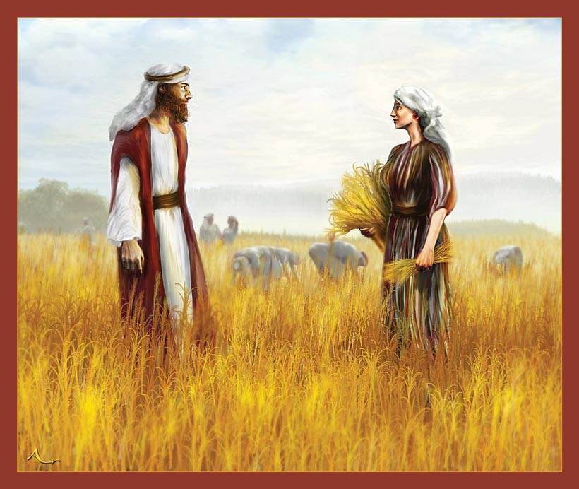
GOD IS SO ADAMANT IN MAINTAINING THIS DIFFERENCE BETWEEN MEN AND WOMEN.
FINAL CONSIDERATION
HE CALLS IT AN ABOMINATION WHEN WE BREAK IT!

Slide 49
The attitude of many today is, “How much do i have to do to be saved?” The attitude of a christian is, “How much can I do to please my saviour?” If you live by that attitude, you wil have no problem with holiness!

Slide 50
END OF PRESENTATION
Presented by: JHT

